Slide 1
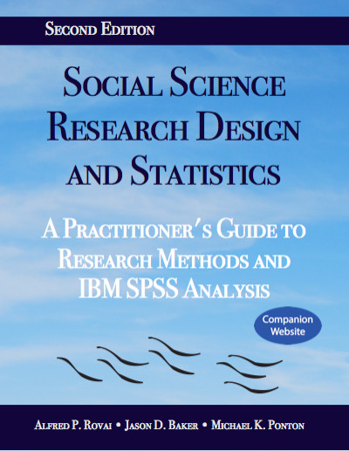
Social Science Research Design and Statistics, 2/e
Alfred P. Rovai, Jason D. Baker, and Michael K. Ponton
Selecting Cases
PowerPoint Prepared by
Alfred P. Rovai
IBM® SPSS® Screen Prints Courtesy of International Business Machines Corporation,
© International Business Machines Corporation.

Slide 2
Selecting Cases
SPSS allows one to select a subset of cases for further analysis, while excluding the remaining cases from various analyses.
The following options are provided.
  All Cases. This option removes any previous selection and subsequent analyses use all data in the dataset.
  If Condition is satisfied. This option allows one to specify a selection rule, e.g., select cases if gender = 1, based on variable values.
  Random sample of cases. This option allows one to select a specified % of all cases or a fixed number of cases at random.
  Based on time or case range. This option allows one to identify a range of cases based on dataset case numbers.
  Use filter variable. This option uses a filter variable that has values of 1 or 0 only; cases with a 1 are included and the cases with 0 are excluded.
The select cases procedure works similarly to the split file procedure. The difference is that one uses the select cases procedure to display analysis for the selected cases only, e.g., male cases only. The split file procedure is used to repeat the same analyses, separately, on multiple groups at the same time. For example, if one intends to compute descriptive statistics of females and males separately, one would use the split file procedure.

Slide 3
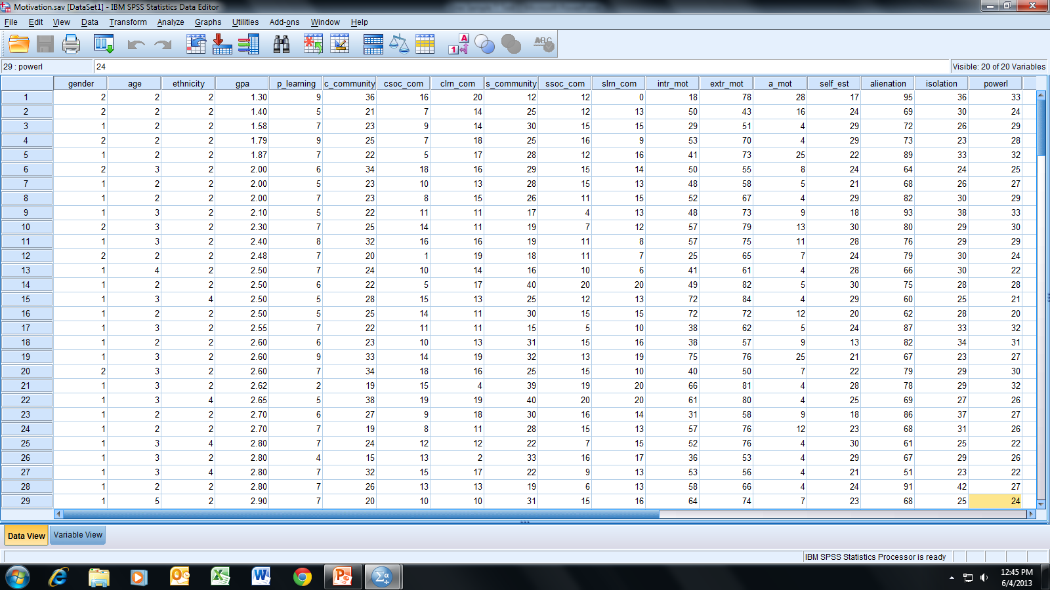
Open the dataset Motivation.sav.
File available at http://www.watertreepress.com/stats
TASK
Select males with a GPA of 3.0 or higher.

Slide 4
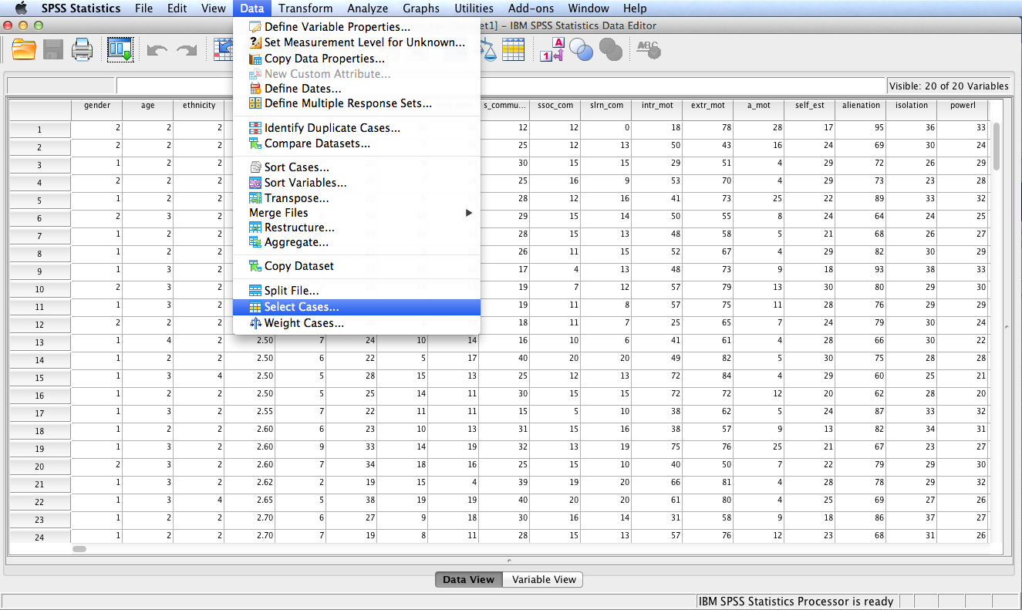
Follow the menu as indicated.

Slide 5
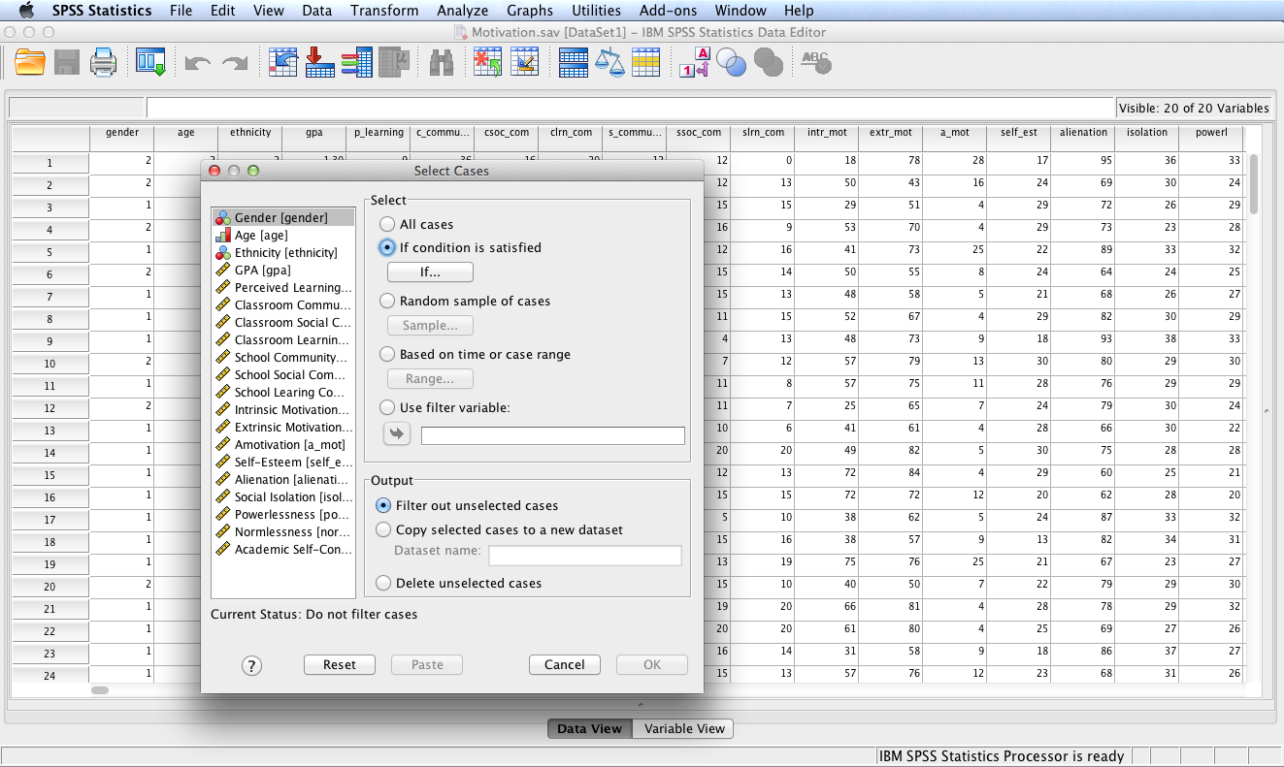
Check the If condition is satisfied radio button and the click the If… button.

Slide 6
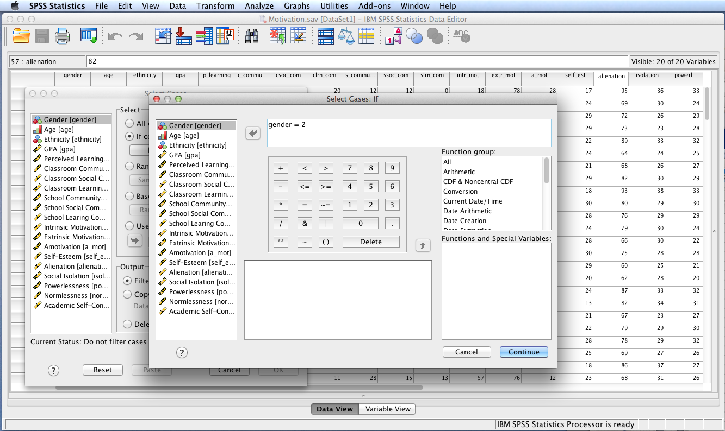
Move Gender to the Conditional Expression box. Build the conditional expression using the appropriate buttons on the key pad to select all males. Note: the dataset is coded such that females = 1 and males = 2.

Slide 7
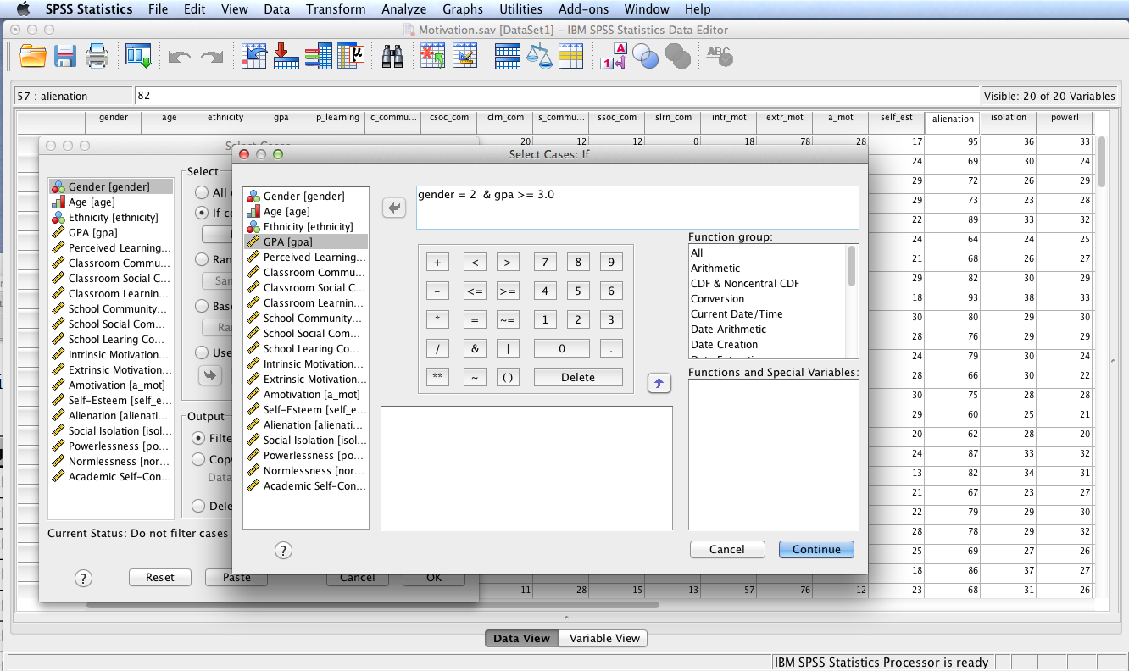
Add an ampersand symbol to separate conditional expressions and then add a second conditional expression to satisfy the condition that GPA must be 3.0 or above. Use the appropriate buttons on the calculator pad. Click continue.

Slide 8
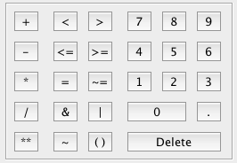
Calculator Pad
Calculator Pad Operators
+ Addition
- Subtraction
* Multiplication
/ Division
** Exponentiation
= Equal to
< Less than
> Greater than
<= Less than or equal to
>= Greater than or equal to
~= Not equal to
& And (both relations must be true)
| Or (either relation must be true)
~ Not (reverses the expression outcome)
() Determines the order of operations

Slide 9
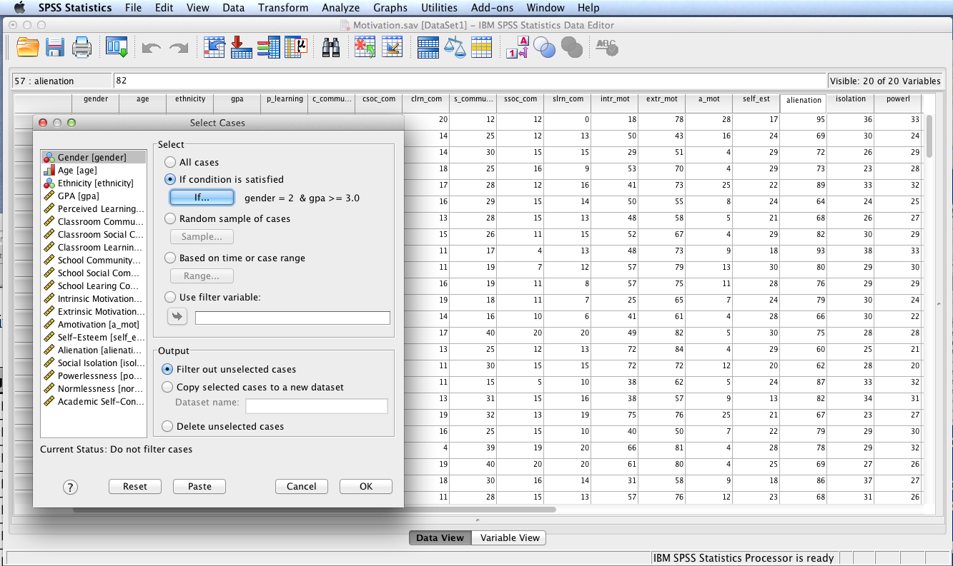
Note that the two conditions are accurately displayed next to the If button. Click OK.

Slide 10
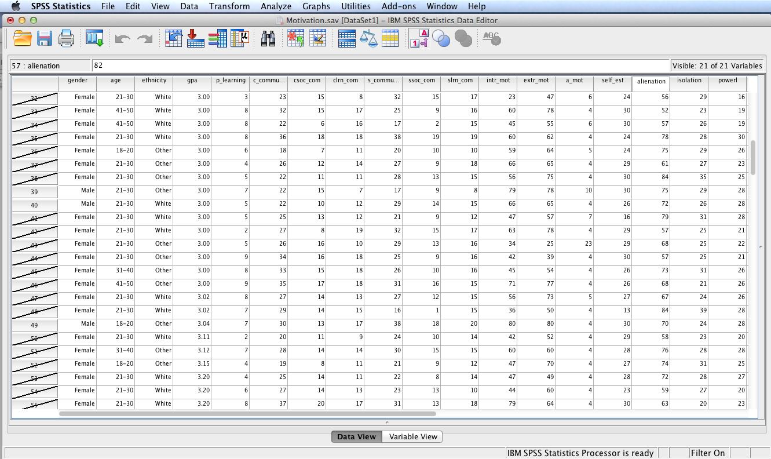
SPSS executes the procedure and Data View displays a slash through all case numbers that are not selected. All subsequent procedures executed using this filtered dataset will use only the non-filtered cases.

Slide 11
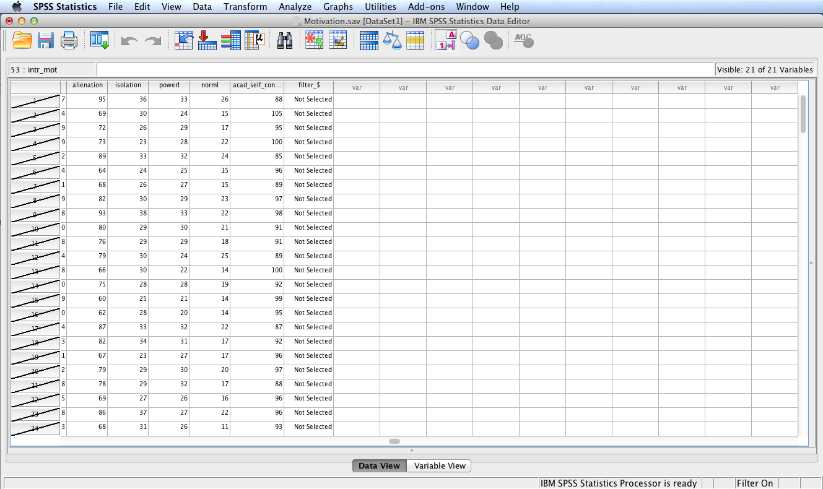
Note that SPSS creates a new variable in the last column of the Data Editor with the name filter_$ (you can rename this variable, as appropriate). This variable contains either 0 (Not Selected) or 1 (Selected) for each case, depending on whether or not the case meets the selection criteria. One can save the dataset with this new variable and use it in subsequent analyses in order to easily apply the previously defined selection criteria using Use filter variable: in the Select Cases dialog.

Slide 12
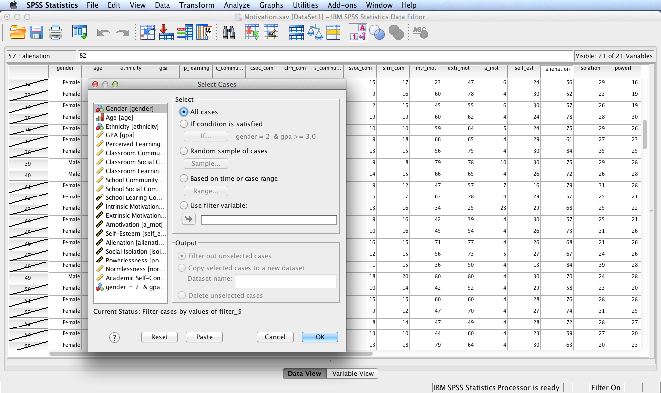
To use all cases one must use the Select Cases procedure again and check the All cases radio button and click OK.

Slide 13
End of Presentation

